Slide 1

Vue.js (Options API)
Andrew Rutherfoord
Notes:
What is Vue.js?
JS Frawework
3rd most popular framework
It’s quite simple and easy to learn
Intuitive syntax
Reactive components
Quite modular (Using components)

Slide 2
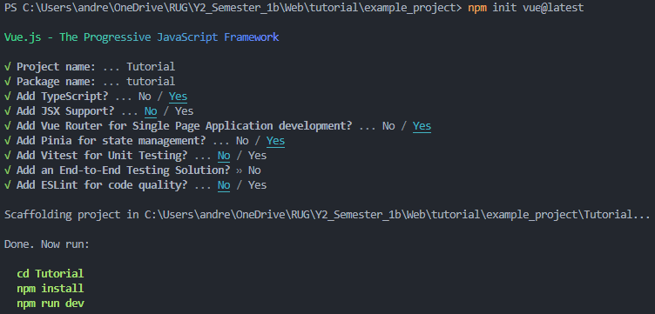
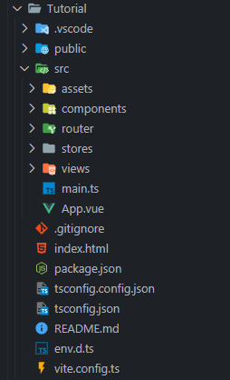
Creating a project

Slide 3
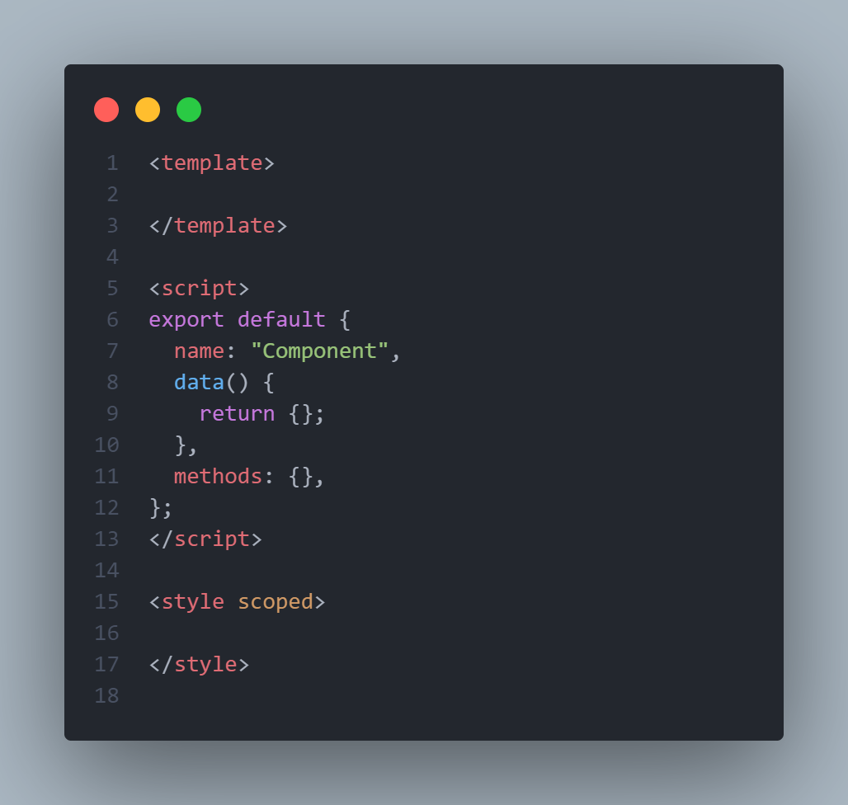
Components
Reusable building block of user interface
Self contained unit with logic, template & styles
Script & Style sections are optional
Use optional scoped key word to only apply styles to that template

Slide 4
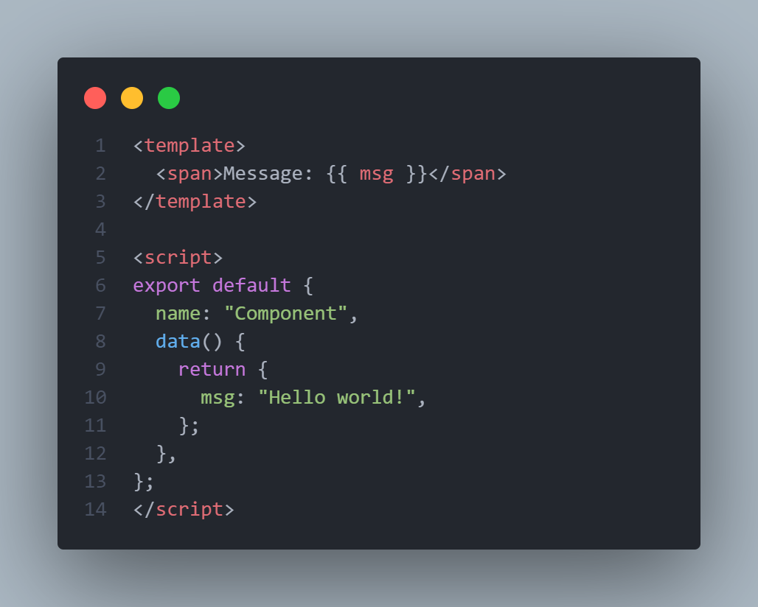
Templating
Normal HTML within <template> tag
Put data variable in {{ }} to display it
Reactive
Notes:
Normal html is used within the template tags. All styling defined elsewhere will be applied to the template (E.g. styles loaded in the index

Slide 5
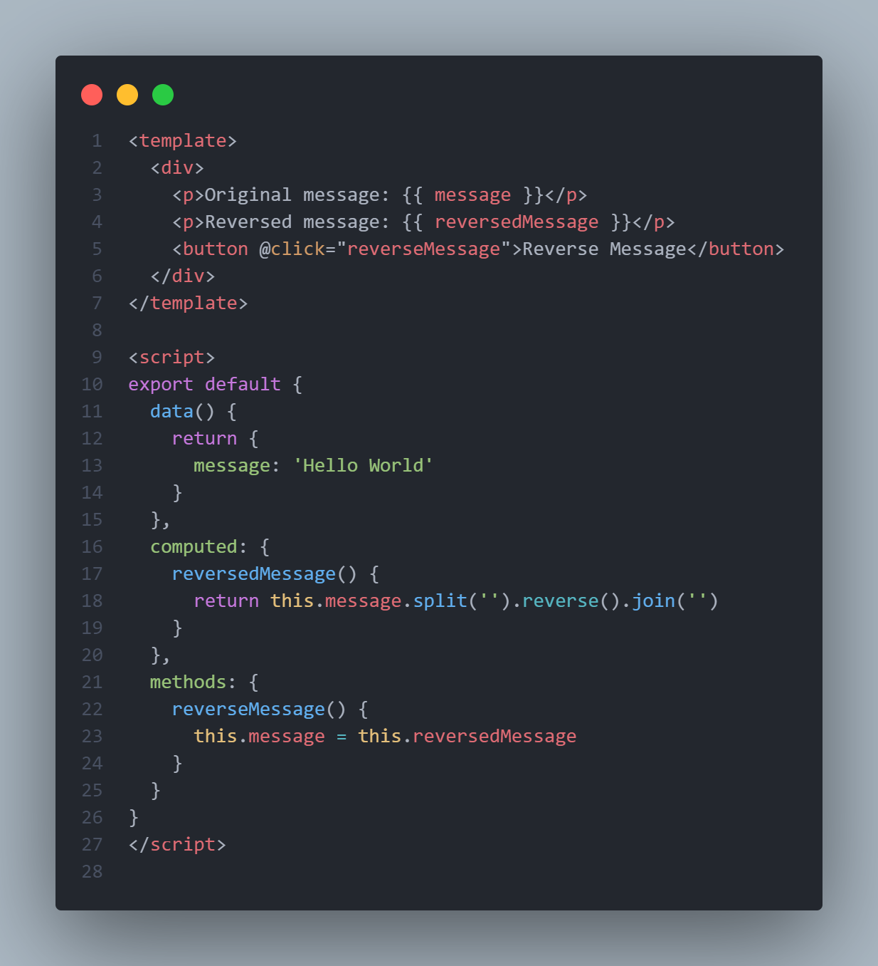
Methods, Data & Computed
`data` holds the state of the vue component
`data` is reactive (Component re-renders on change)
`computed` values are re-evaluated on change of data vars used
`methods` holds functions
`methods` invoked in lifecycle, other methods or event handlers
Are all accessed with `.this`

Slide 6
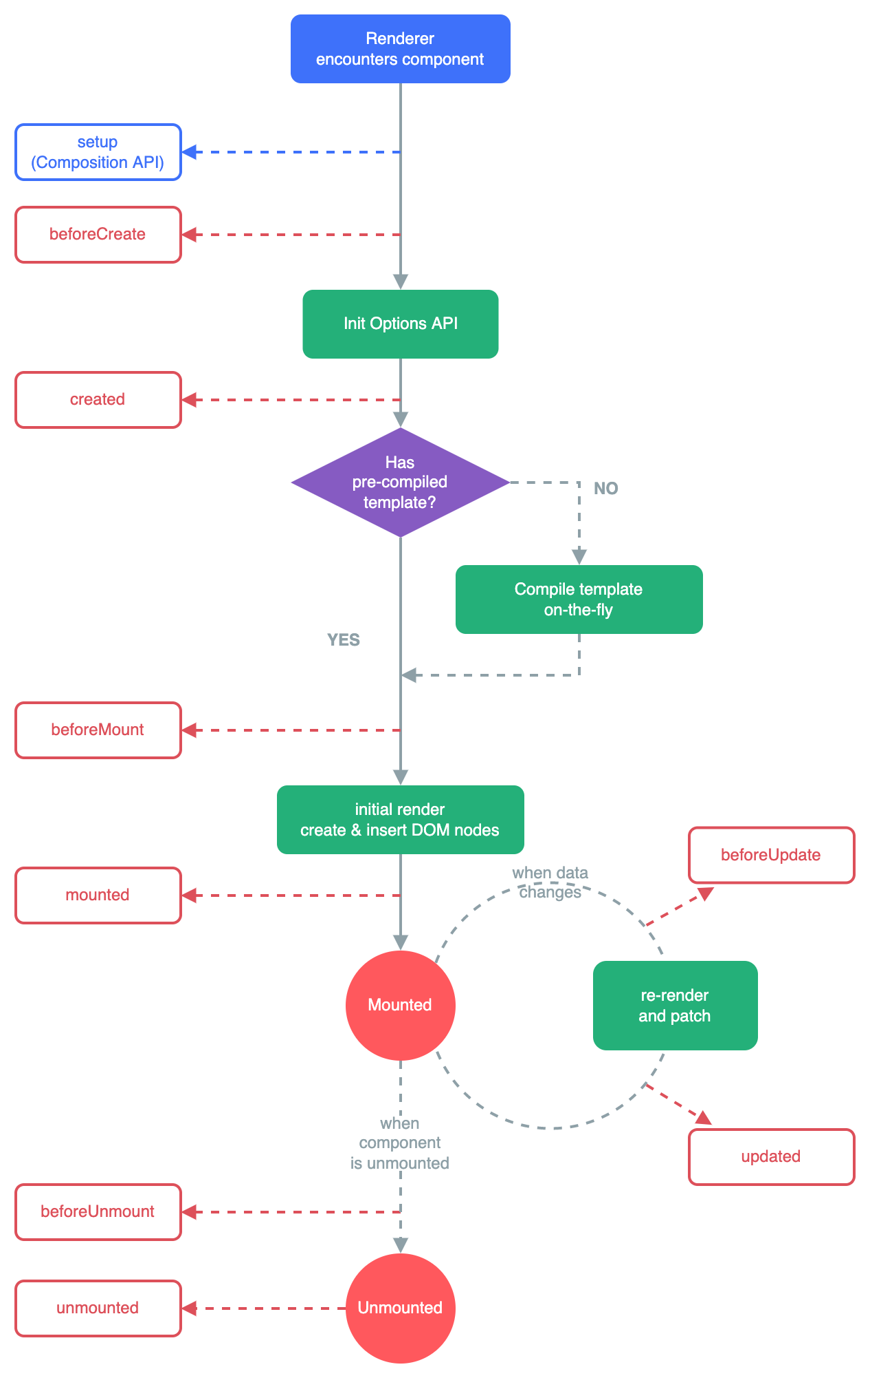
Lifecycle hooks
Allow code to be run at specific times in the lifecycle of the component
https://vuejs.org/assets/lifecycle.16e4c08e.png

Slide 7
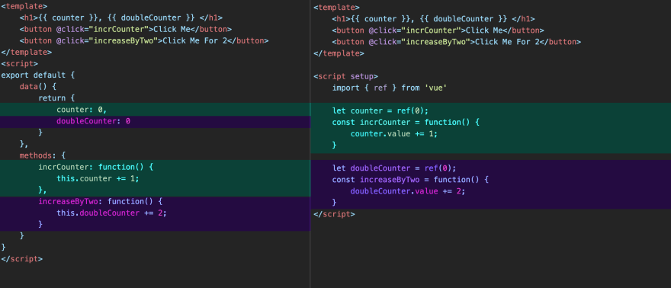
Difference Between Options & Composition API
https://dev.to/smpnjn/the-difference-between-the-composition-api-and-options-api-in-vue-2m7c

Slide 8
Directives
`v-bind`: Bind data to html attribute, or Vue component
`v-on`: Attach event listener to an element
`v-model`: Two-way data binding between form element & JS variable
`v-for`: Render lists
`v-if`: Conditionally render elements
Notes:
Used to bind data to a component’s view.
Starts with `v-`

Slide 9
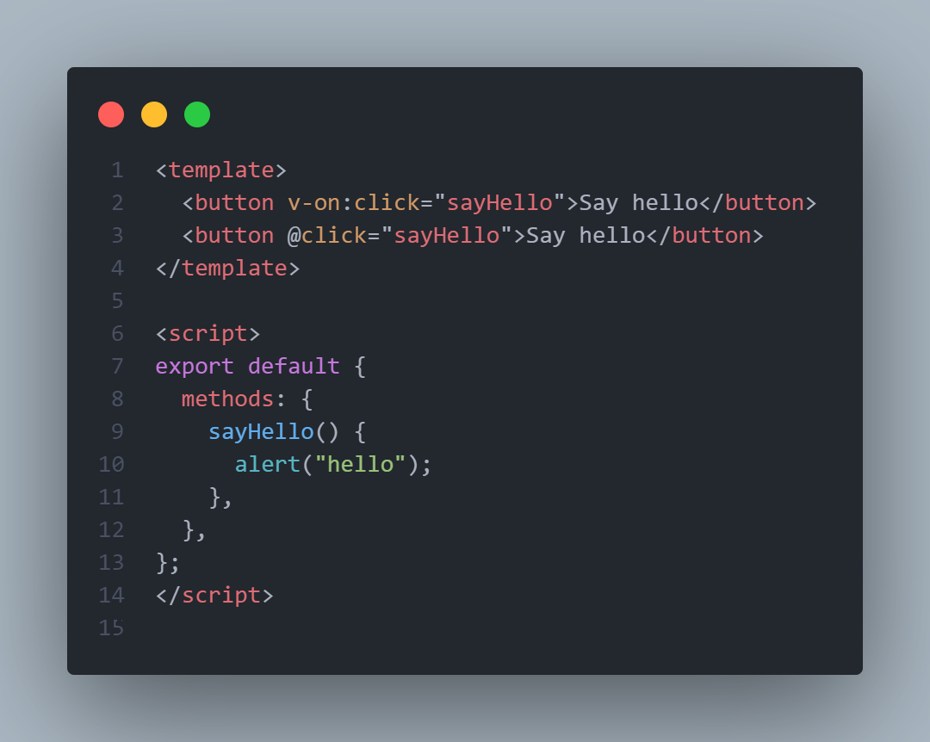
Directives: v-on
Both `v-on:` and `@`do the same thing.
`@` is an alias
Attaches an event listener to element
On button click, method executed

Slide 10
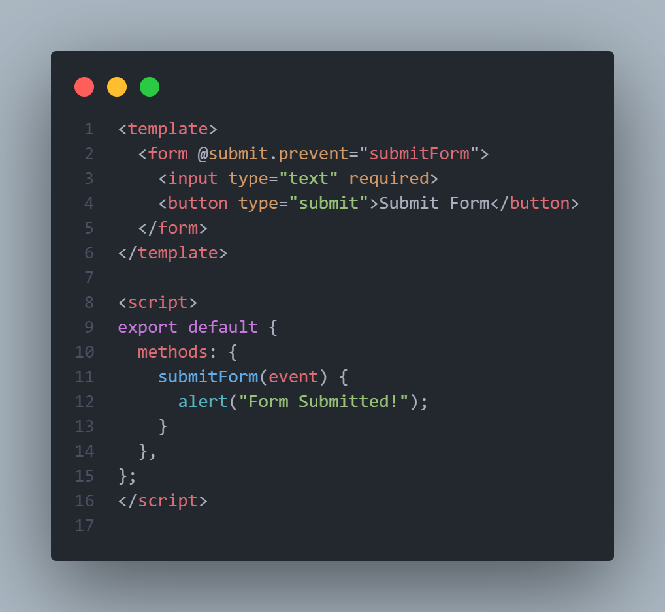
Directives: v-on
Using v-on hook for submission of form
Prevents default form submission operation
Allows use of the html form default required behavior
Event passed as parameter to method

Slide 11
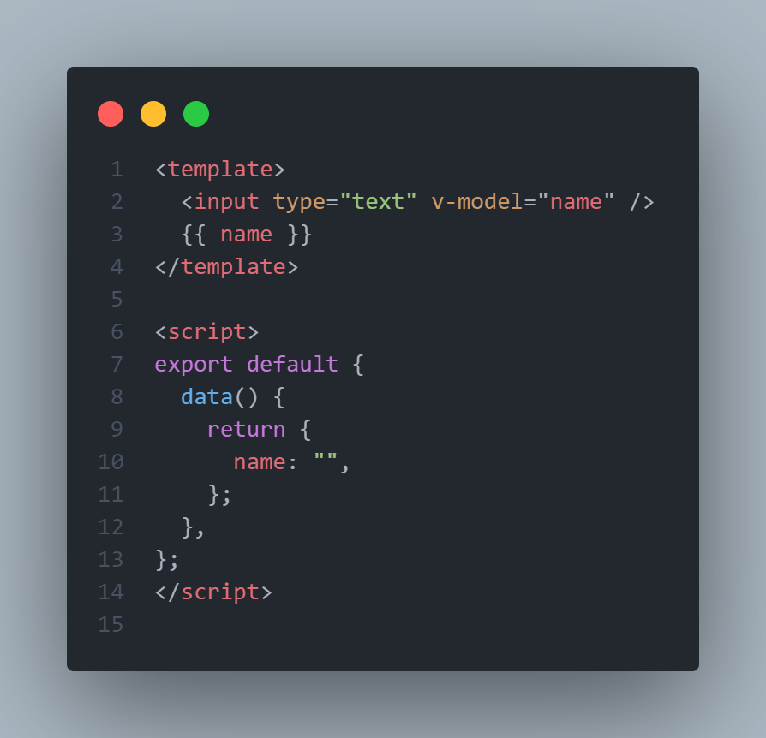
Directives: v-model
Allows form element data to be synced with state
As name input filled, will be reflected in the template output
Very useful directive

Slide 12
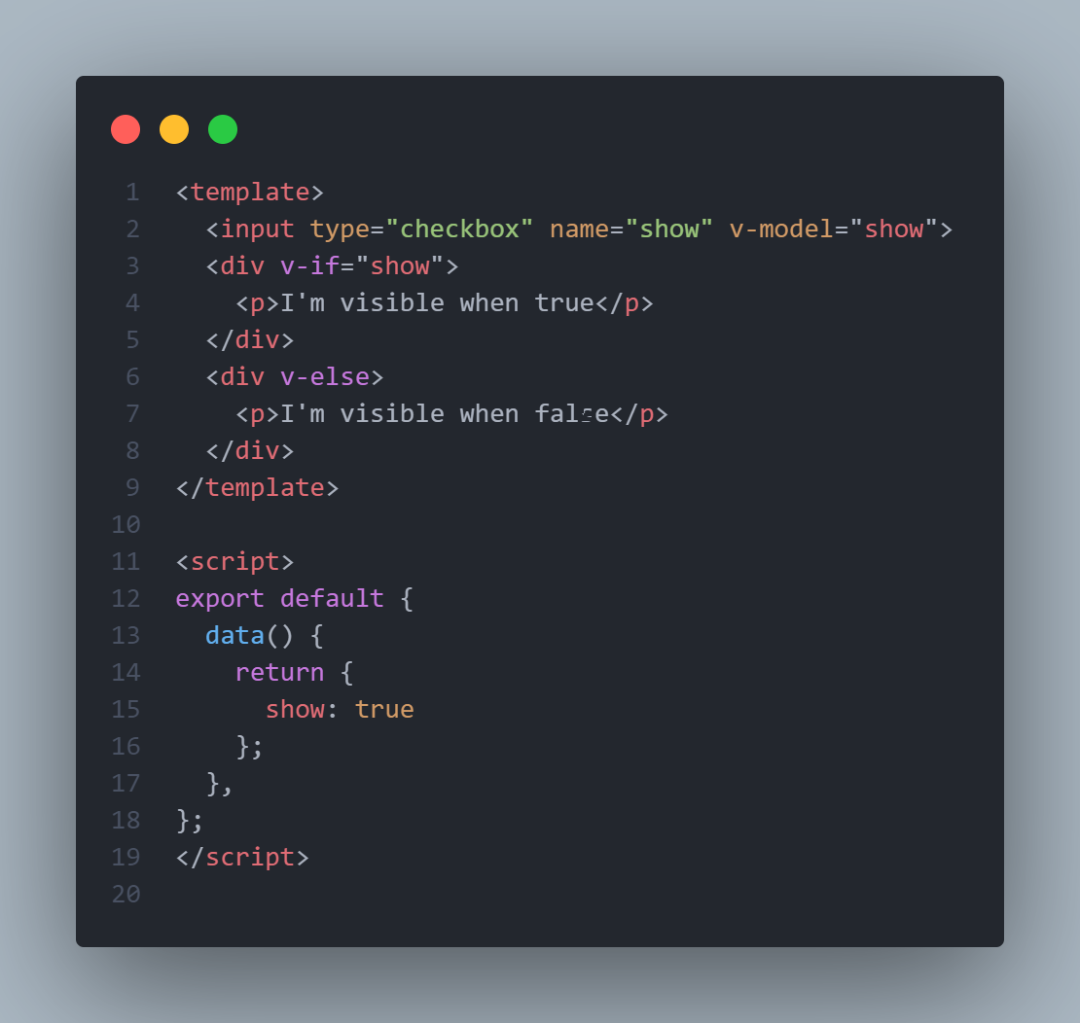
Directives: v-if & v-else
div with v-if will be dynamically shown or hidden based on state of `show`
Another example of v-model

Slide 13
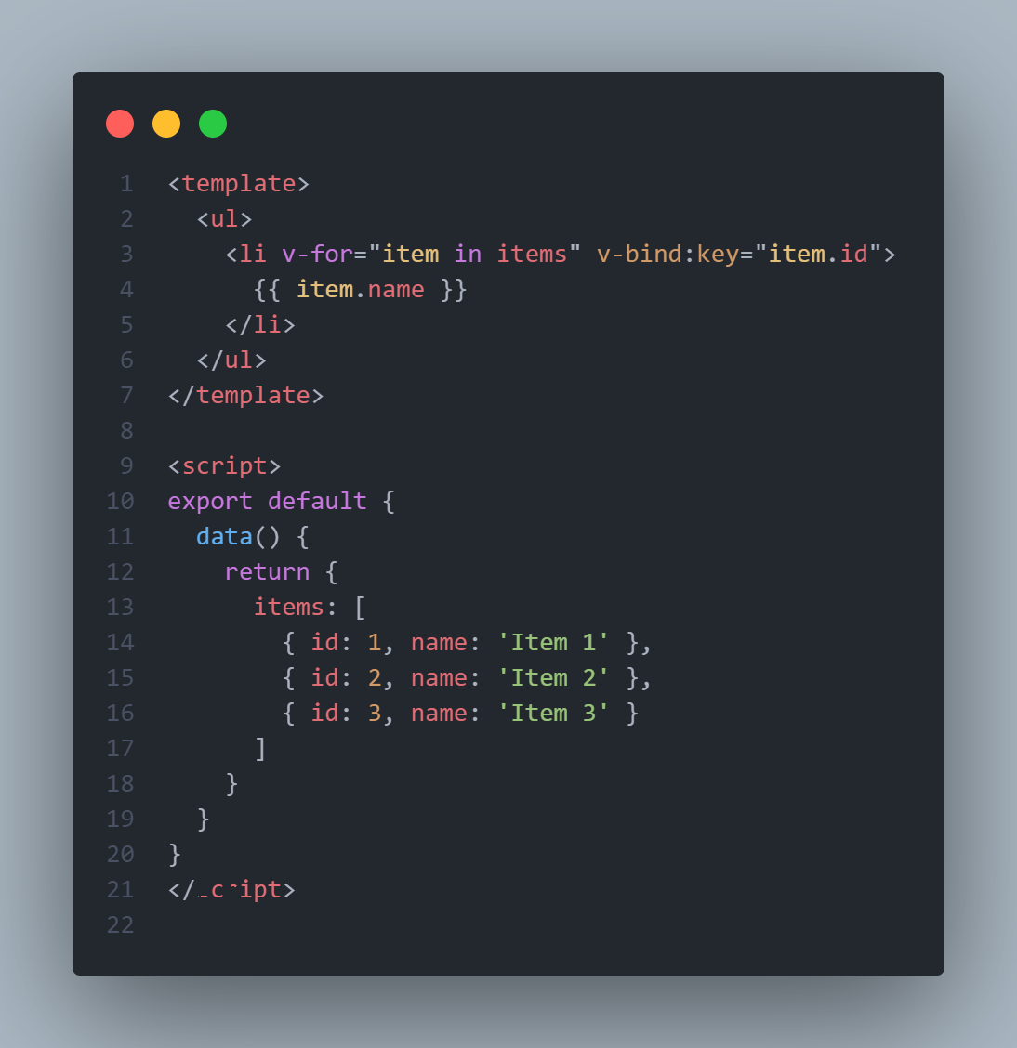
Directives: v-for
Used to render lists of items
Takes a list as argument and renders an element for each item

Slide 14
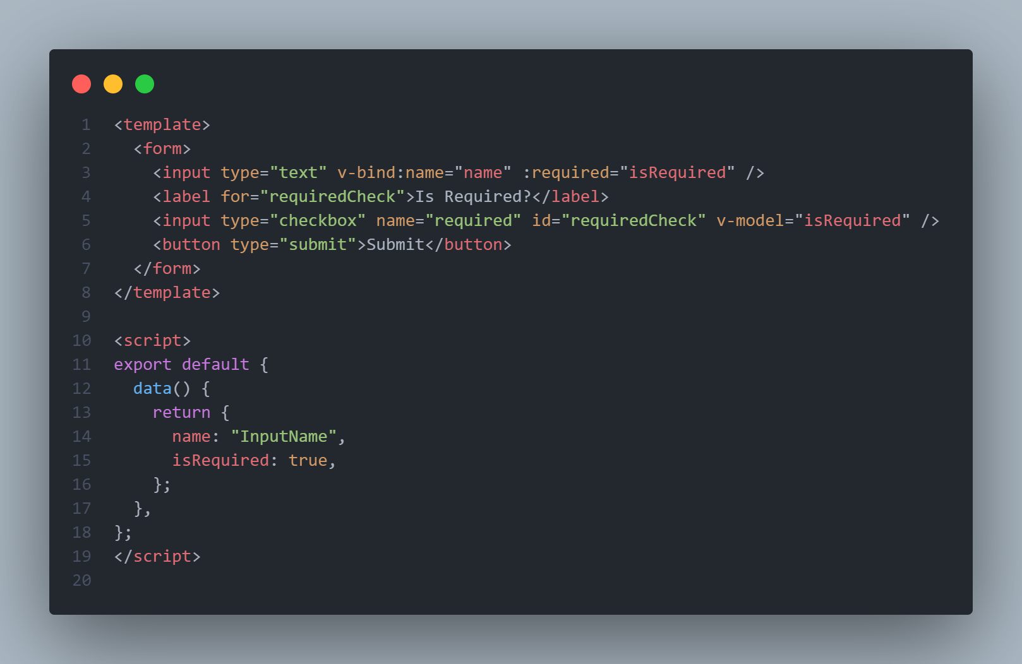
Directives: v-bind
Used to bind data to html elements and components
Allows dynamically setting value for attribute
Example of binding to html element

Slide 15
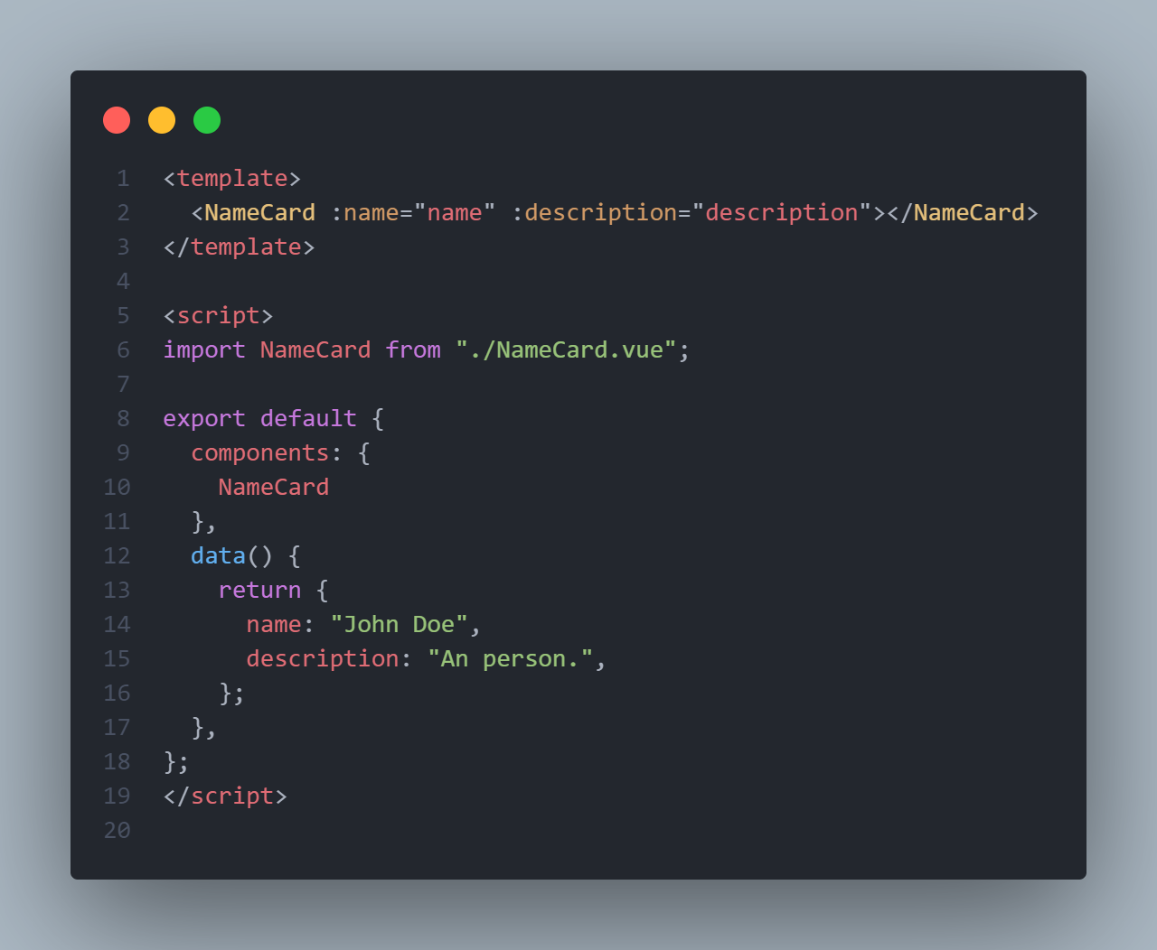
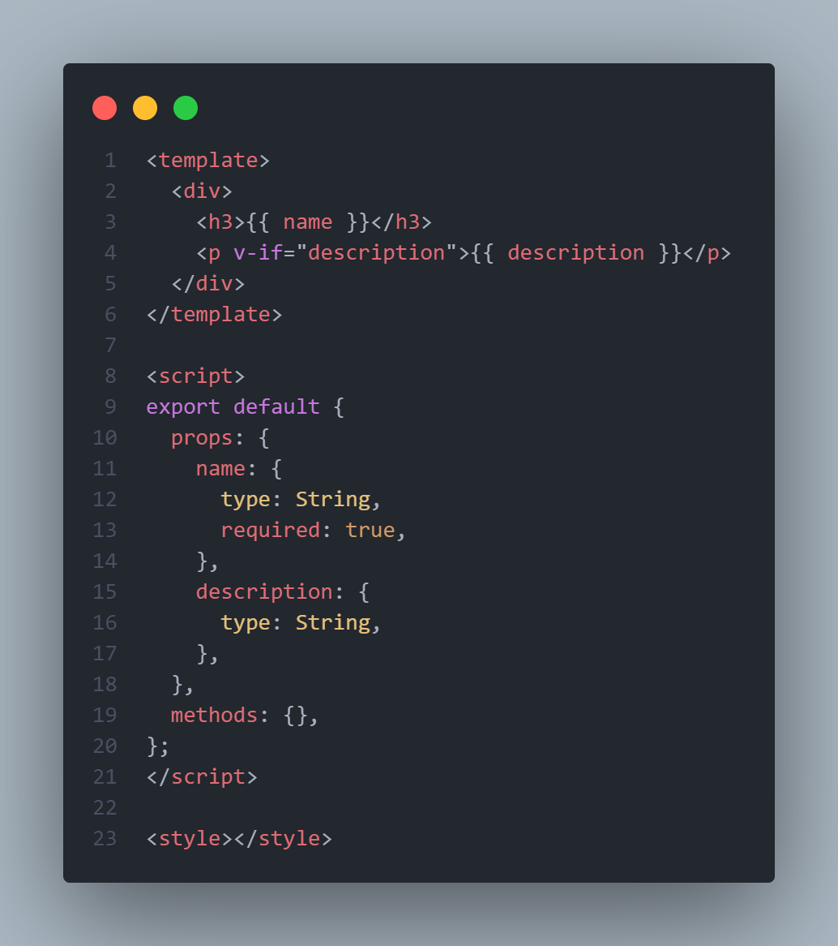
Vue Component Props
Way for components to accept data from parent component

Slide 16
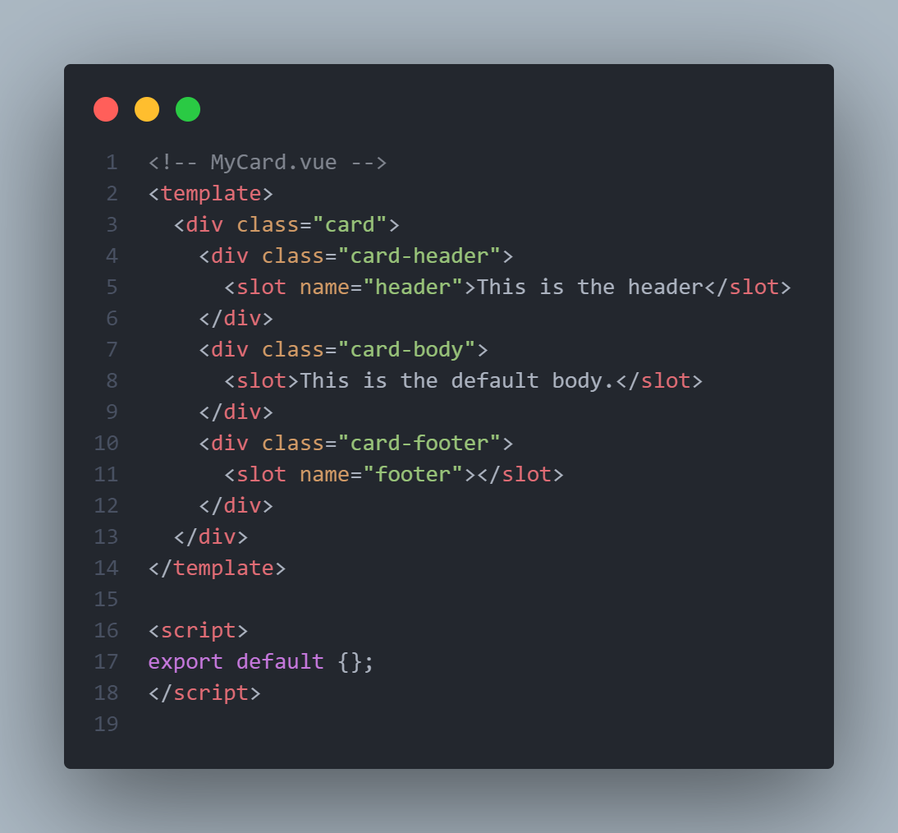
Slots
Provides a way for parent to define content of child
Can also provide placeholder/default content
Parent content will override default if present
(Example usage on next slide)

Slide 17
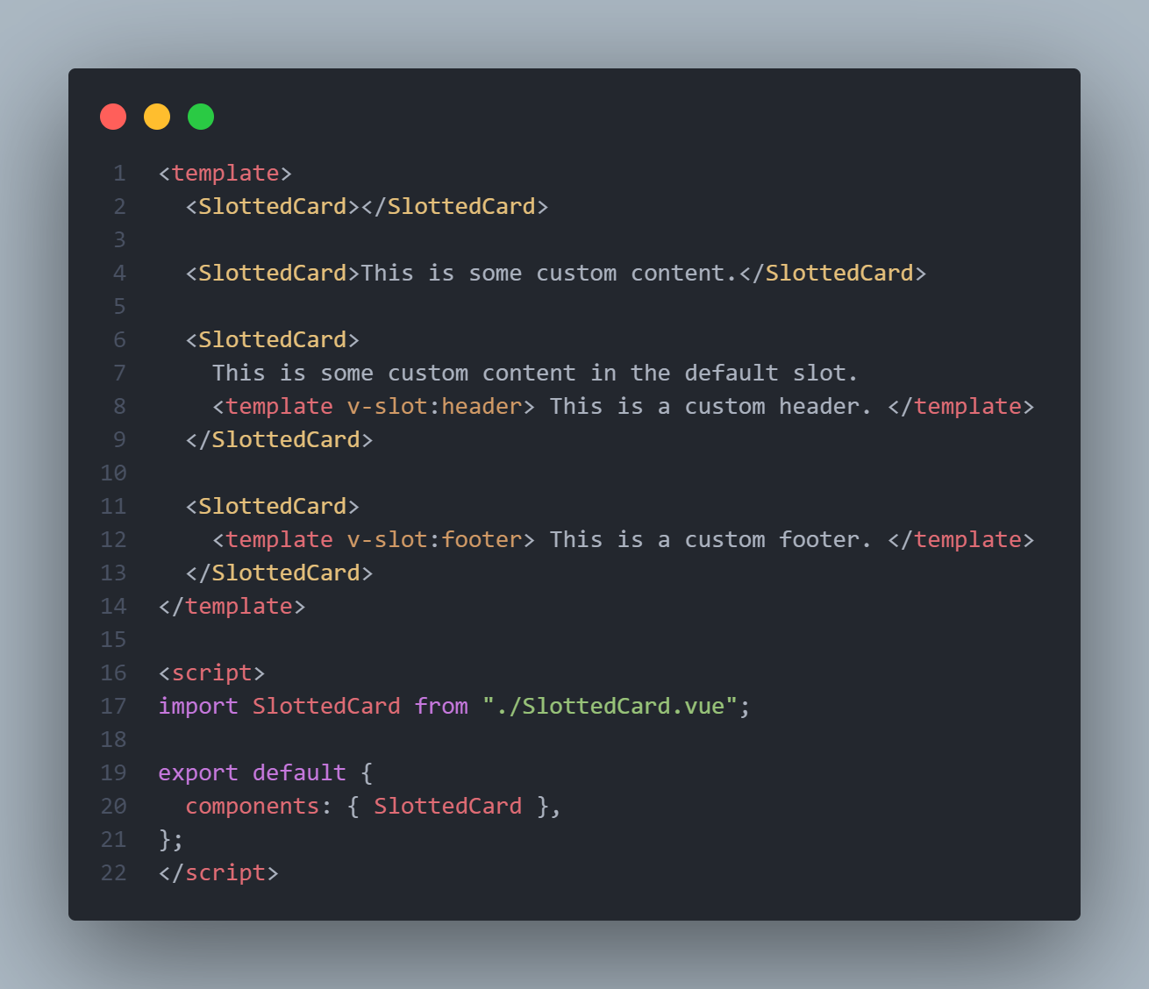
Slots – continued
Providing custom content to default slot in first example
Using names slot `header` in second example
Default slot does not have to be filled

Slide 18
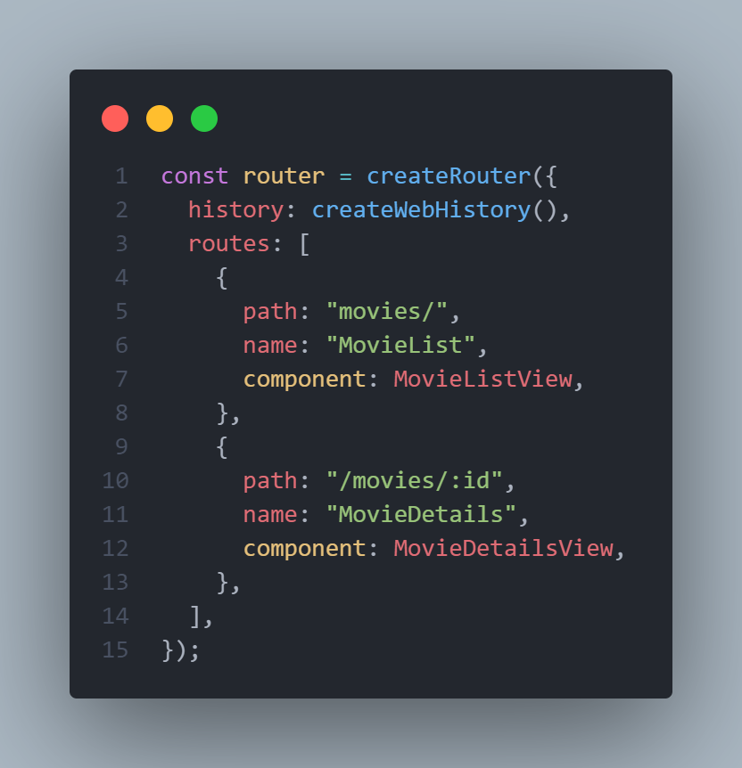
Vue Router
Provides client-side routing on a Vue.js application
Allows mapping of URLs to different components.
Each route can be referenced by it’s name
Add url parameters with `:`
Accessed with `this.$route.params.id`

Slide 19
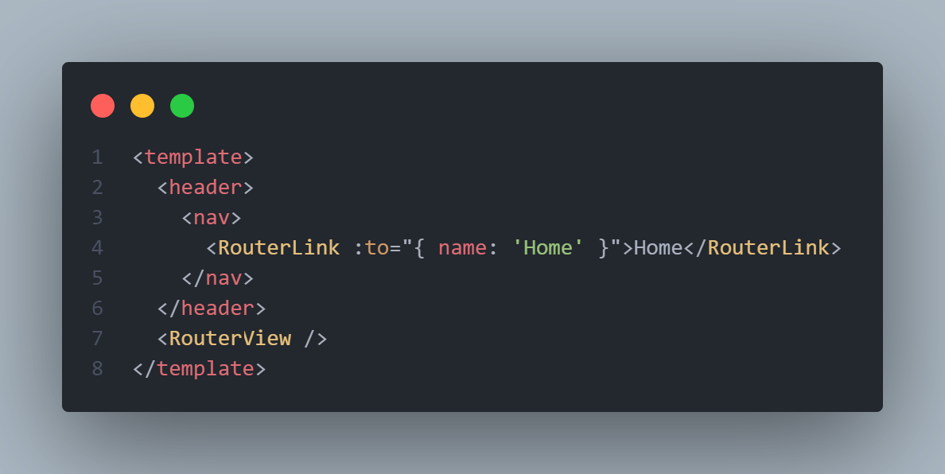
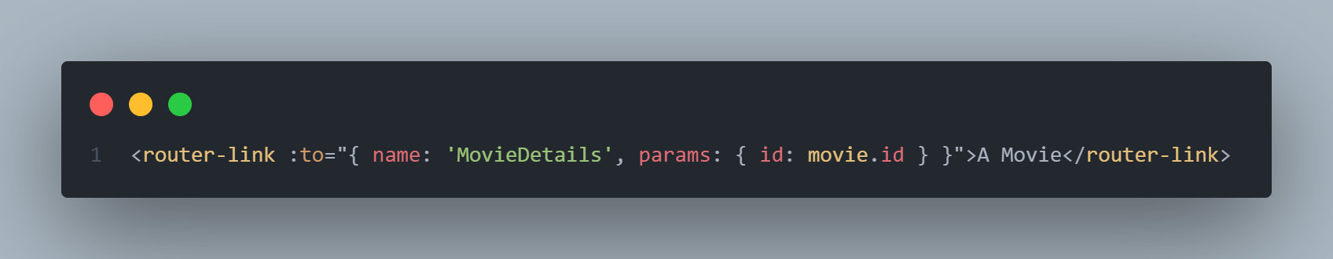
Router
This is in the `App.vue`
`RouterView` where components in router are rendered
`RouterLink` similar to `a` tag
Define route to go to with name

Slide 20
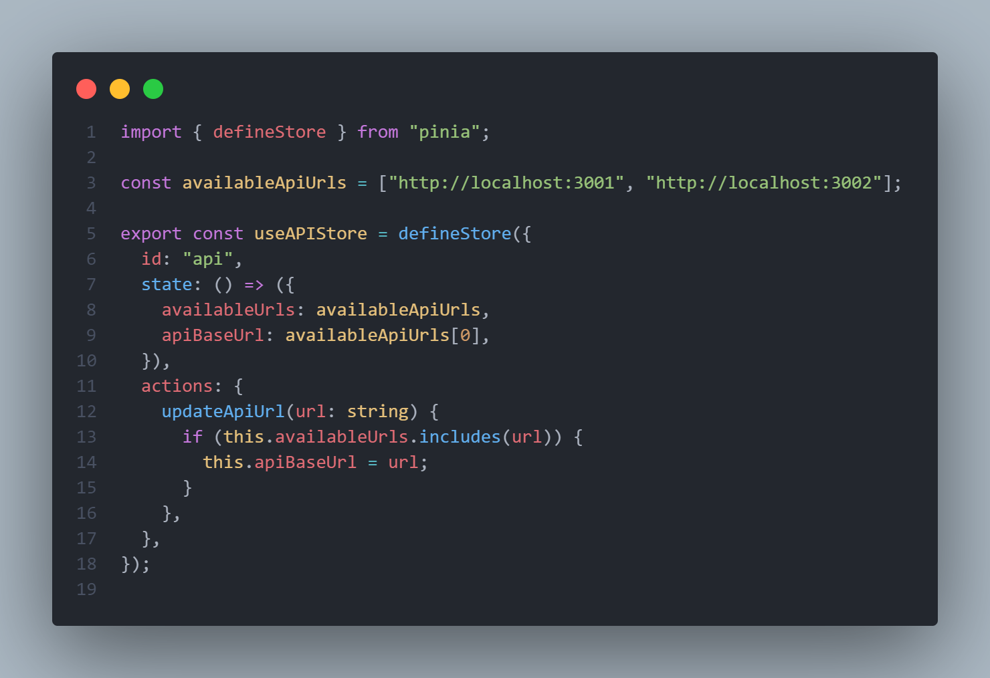
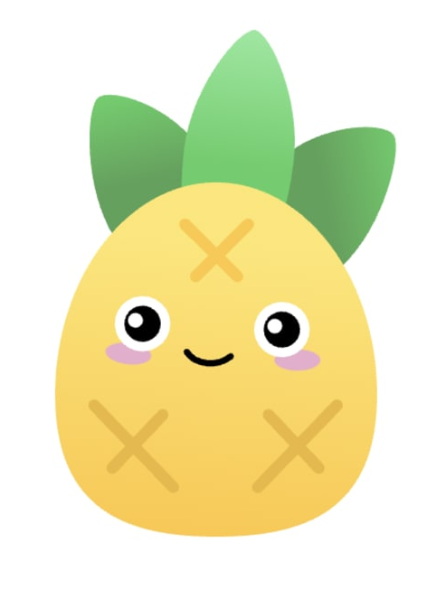
Vue Storage with Pinia
State management package (Replacing Vuex)
Central store to hold stat in vue app
Can be accessed from any component
Accessed and modified by mapping state or methods to component
State altered with methods or directly
Cleared on refresh

Slide 21
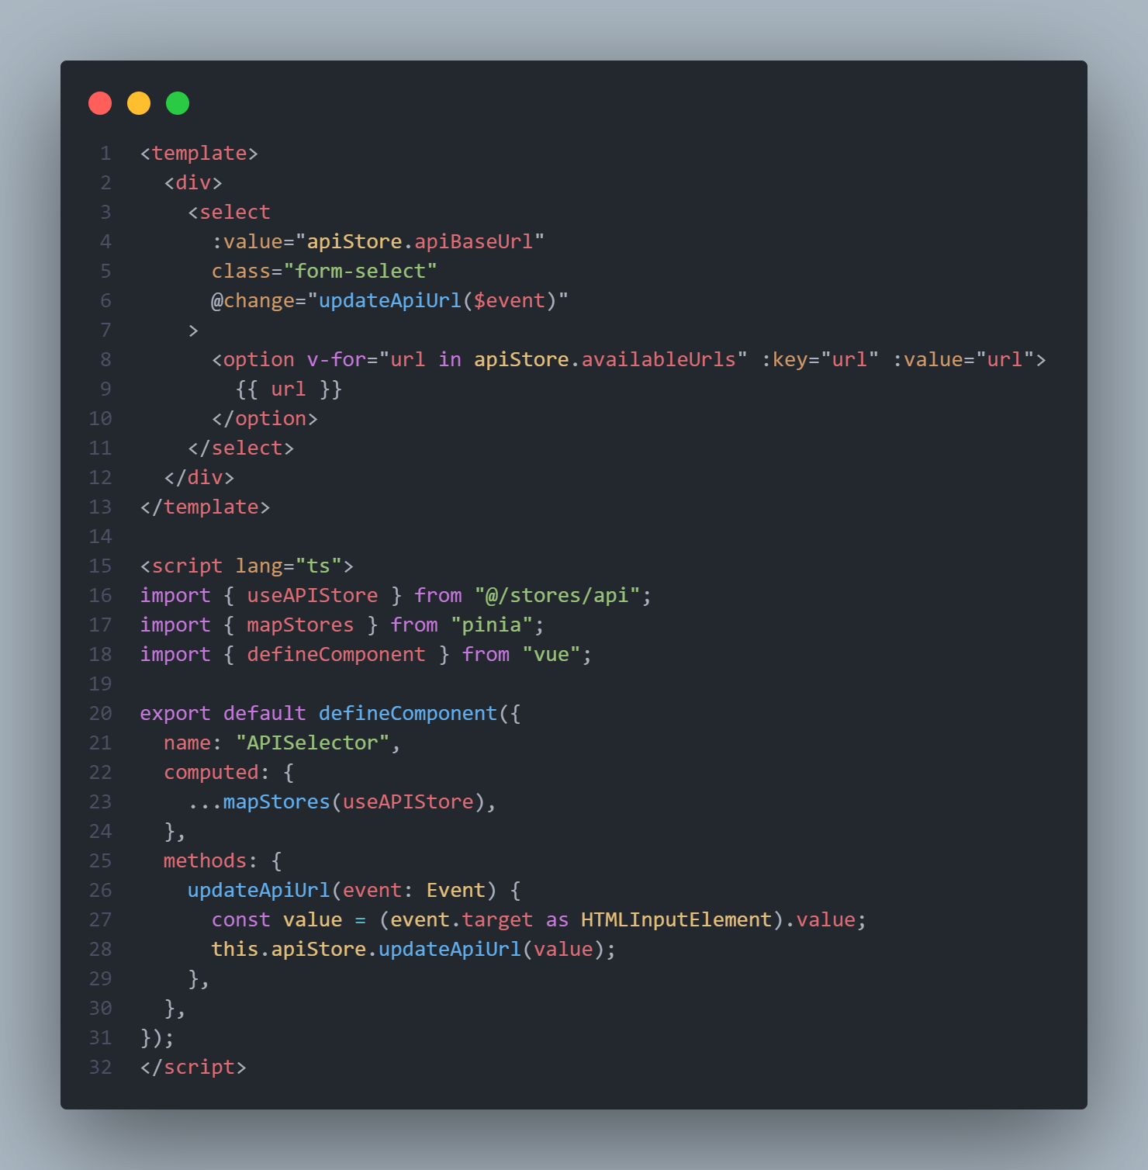
Usage of store

Slide 22
Time to Build a Basic Frontend

